Slide 1


Slide 2
AJAX
AJAX = Asynchronous JavaScript And XML.
AJAX is not a programming language. It just uses:
A browser built-in XMLHttpRequest object (to request data from a web server)
JavaScript and HTML DOM (to display or use the data)
AJAX is a misleading name. AJAX applications might use XML to transport data, but it is equally common to transport data as plain text or JSON text.
AJAX allows web pages to be updated asynchronously by exchanging data with a web server behind the scenes.
This means that it is possible to update parts of a web page, without reloading the whole page. Everything else in the page keeps working while we wait for the data.
Notes:
AJAX is an asynchronous XMLHttpRequest

Slide 3
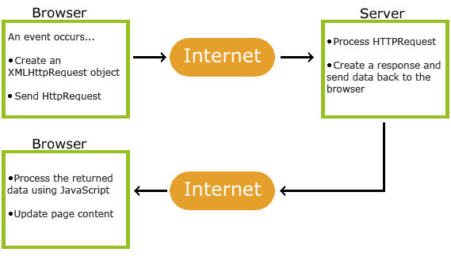
AJAX

Slide 4
AJAX
1. An event occurs in a web page (the page is loaded, a button is clicked)
2. An XMLHttpRequest object is created by JavaScript
3. The XMLHttpRequest object sends a request to a web server
4. The server processes the request
5. The server sends a response back to the web page
6. The response is read by JavaScript
7. Proper action (like page update) is performed by JavaScript
NOTE: both the web page and the files you are trying to load must be located on the same server.

Slide 5
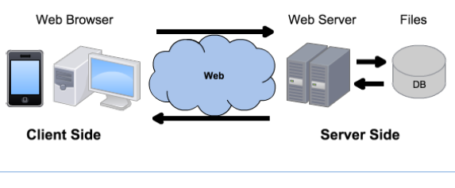
Linux
Windows
MacOS
Android
Linux
Windows Server
Apache
Tomcat
IIS
NodeJS
MySQL
Oracle
SQL Server
MongoDB
Chrome
Firefox
Safari
AJAX
XMLHttpRequest
XML
JSON
text
HTML
CSS
JavaScript
PHP
Java
ASP
JavaScript
Bootstrap
SQL
JSON
jQuery
Notepad++
Eclipse
Visual Studio

Slide 6
Example: text file on server
myTutorials.txt, in JSON array format
[
{
"display": "HTML Tutorial",
"url": "https://www.w3schools.com/html/default.asp"
},
{
"display": "CSS Tutorial",
"url": "https://www.w3schools.com/css/default.asp"
},
{
"display": "JavaScript Tutorial",
"url": "https://www.w3schools.com/js/default.asp"
},
{
"display": "jQuery Tutorial",
"url": "https://www.w3schools.com/jquery/default.asp"
}
]

Slide 7
Example: XMLHttpRequest() object
<script> xmlhttp = new XMLHttpRequest(); url = "myTutorials.txt"; xmlhttp.onreadystatechange = function() { if (xmlhttp.readyState == 4 && xmlhttp.status == 200) { // finished and OK myArr = JSON.parse(xmlhttp.responseText); //string turned to object myFunction(myArr); //callback function } } xmlhttp.open("GET", url, true); //true asynchronous xmlhttp.send(); function myFunction(myArr) { out = ""; for(i = 0; i < myArr.length; i++) { out += '<a href="' + myArr[i].url + '">' + myArr[i].display + '</a><br>';
// <a href="http://www.w3schools.com">Visit W3Schools</a><br> } document.getElementById("example").innerHTML = out; } </script>
Notes:
4: request finished and response is ready
200: "OK"

Slide 8
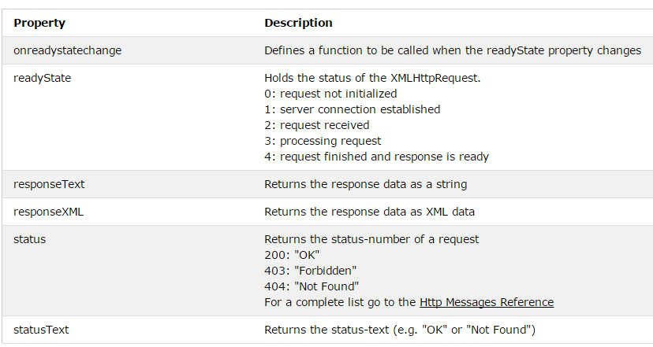
XMLHttpRequest object properties
Notes:
The onreadystatechange event is triggered four times (1-4), one time for each change in the readyState.

Slide 9
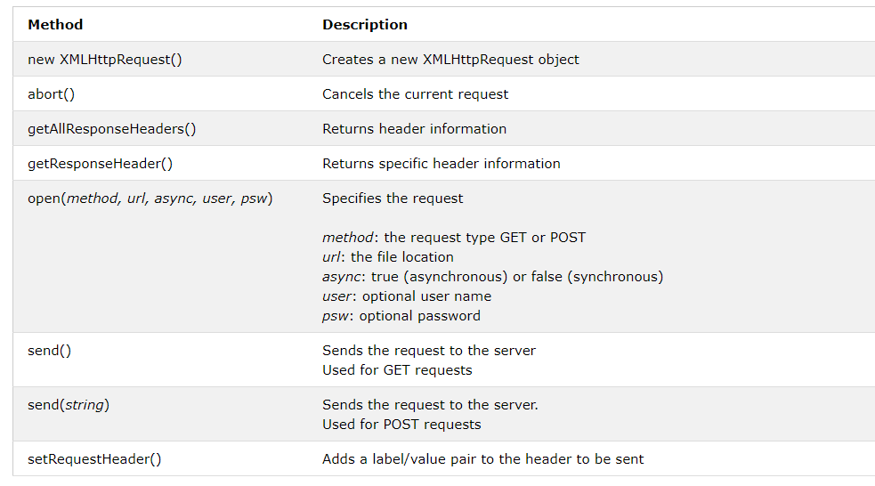
XMLHttpRequest object methods
URL may be .txt .xml .json or scripts like .js and .php that return data
Notes:
The fetch API offers simpler code than AJAX, but browser support for aborting requests is still under development, and it is not supported by Internet Explorer yet.

Slide 10
GET or POST?
GET is simpler and faster than POST
To avoid getting a cached result, add an unique ID to the URL
xhttp.open("GET", "server.js?t=" + Math.random(), true);
However, always use POST requests when:
Updating a file or database on the server (when you can’t guarantee to work around a cashed file).
Sending a large amount of data to the server (POST has no size limitations).
Sending user input, which can contain unknown characters (POST is more robust and secure than GET).
Sending sensitive data, like passwords (POST data is not visible in the URL)
Notes:
https://www.w3schools.com/tags/ref_httpmethods.asp

Slide 11
POST Requests
Requesting data without sending any parameters:
xhttp.open("POST", "data.txt", true); xhttp.send();
Sending data with the request:
xhttp.open("POST", "server.js", true); xhttp.setRequestHeader("Content-type", "application/x-www-form-urlencoded"); // Adds HTTP headers to the request xhttp.send("fname=Henry&lname=Ford");

Slide 12


Slide 13
jQuery AJAX
Some older browsers have a different syntax for AJAX implementation.
You would have to write extra code to test for it, e.g.:
var xhttp;
if (window.XMLHttpRequest) xhttp = new XMLHttpRequest(); else // code for IE6, IE5 xhttp = new ActiveXObject("Microsoft.XMLHTTP");
jQuery handles cross-browser compatibility, and we can write AJAX with a single line of code.
jQuery is likely already included in a Bootstrap page.

Slide 14
jQuery
In your .html, include jQuery from a CDN, e.g.:
<script src="https://code.jquery.com/jquery- 3.3.1.min.js"></script>
The syntax is: $(selector).action
The jQuery selector uses CSS selectors to select elements.
Examples:
$("p").hide() - hides all <P> elements
$(" .test").hide() - hides all elements with class="test"
$("#test").hide() - hides the element with id="test"

Slide 15
jQuery AJAX: load
Load data from the server and place the returned content into the matched HTML elements.
$(selector).load(URL, data, callback);
the optional data parameter specifies a set of query string key/value pairs to send along with the request.
$("#div1").load("test.txt");
loads the content of the file "test.txt", into the element with id “div1”

Slide 16
jQuery AJAX: load
The optional callback parameter is the name of a function to be executed after the load() method is completed.
The callback function can have different parameters:
responseTxt - contains the resulting content if the call succeeds
statusTxt - contains the status of the call
xhr - contains the XMLHttpRequest object

Slide 17
jQuery AJAX: load
$("#div1").load("test.txt", function(responseTxt, statusTxt, xhr){ if(statusTxt == "success") alert("External content loaded successfully!"); if(statusTxt == "error") alert("Error: " + xhr.status + ": " + xhr.statusText); });
The POST method is used if data is provided as an object; otherwise, GET is assumed.

Slide 18
jQuery AJAX: GET
$.get(URL, callback);
$.get("server.js", function(data, status){ alert("Data: " + data + "\nStatus: " + status); });
URL is required, the server-side resource you wish to request.
The second parameter is (an optional) callback function. You probably don’t want to ignore the result, though, so you’ll specify the callback.
The first callback parameter holds the content requested, and the second callback parameter holds the status of the request.

Slide 19
jQuery AJAX: POST
$.post(URL, data, callback);
$("#btn1").click(function(){ $.post("server.js", { name: "Donald Duck", city: "Duckburg" }, function(data, status){ alert("Data: " + data + "\nStatus: " + status); }); });
URL is required, the server-side resource you wish to request.
The optional data parameter specifies some key/value parameters to send along with the request.
The optional callback parameter is a function to be executed if the request succeeds, after the response data is loaded.

Slide 20
jQuery AJAX: getJSON()
$(selector).getJSON(url,data,success(data,status,xhr)) // uses GET
// getJSON parses the JSON automatically, so we don't need to call JSON.parse
$("#btn2").click(function(){ $.getJSON("test.json", function(result){ $.each(result, function(i, field){ $("#div1"). append("param: " + i + " data: " + field + "<br>"); }); }); });
As of jQuery 1.4, if the JSON file contains a syntax error, the request will usually fail silently.
Avoid frequent hand-editing of JSON data for this reason.

Slide 21

AJAX in Angular
Modern browsers support two ways of making HTTP requests:
the XMLHttpRequest interface (AJAX)
the fetch() API
The HttpClient in @angular/common/http offers a client HTTP API that rests on XMLHttpRequest, e.g.:
configUrl = 'assets/config.json';
getConfig() {
return this.http.get(this.configUrl);
}
https://angular.io/guide/http
The benefits of HttpClient include request and response interception and streamlined error handling.
In AngularJS, it’s called $http: https://docs.angularjs.org/api/ng/service/$http

Slide 22

AJAX in ReactJS
You can use any AJAX library you like with React.
Some popular ones are:
jQuery AJAX
Axios
You can also use the Browser’s fetch() API.
https://reactjs.org/docs/faq-ajax.html

Slide 23
Node.js Response
Without ExpressJS:
The request object passed in the connection callback is a stream. We must listen for the stream data events, which are processed in chunks. When the data ends, the stream end event is called, once:
http.createServer(function (req, res) {
let data = [];
req.on('data', chunk => {
data.push(chunk);
});
req.on('end', () => {
console.log(JSON.parse(data));
res.write("JSON received, thank you.");
return res.end();
});
}
Notes:
https://nodejs.dev/get-http-request-body-data-using-nodejs

Slide 24
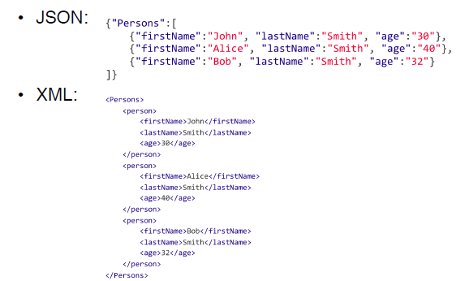
Data format: JSON or XML?

Slide 25
JSON vs XML
Both are plain text, can be parsed and used by multiple languages
Both are self describing (human readable)
Both are hierarchical
Both can be fetched with an XMLHttpRequest
XML has to be parsed with an XML parser to extract values and store in variables
JSON can be parsed by a standard JavaScript function, JSON.parse, and JSON maps to JavaScript objects
JSON is potentially shorter, faster and easier to read and write, especially for AJAX applications

Slide 26

JSON

Slide 27
JSON
JSON (JavaScript Object Notation) is a lightweight text-based open standard designed for human-readable data interchange.
extended from JavaScript
the file type is ".json"
the MIME type for JSON text is "application/json"
language independent data interchange
communication between browsers and servers
communication between peers
JSON has no version number.
No revisions to the JSON grammar are anticipated.
The strict syntax allows the parsing algorithms to remain simple, efficient, and consistent.

Slide 28
JSON Values
Strings // 0 or more Unicode characters
// wrapped in "double quotes"
// backslash used for escape characters
Booleans // true or false
Numbers
Objects
Arrays
null

Slide 29
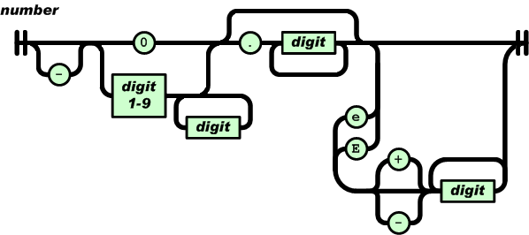
JSON Numbers
Integer
Real
Scientific
No octal or hex
No NaN or Infinity
Use null instead

Slide 30
JSON Objects
Objects are unordered containers of key/value pairs
Objects are wrapped in { }
Keys are strings
Values are JSON values
: separates keys and values
, separates key/value pairs

Slide 31
JSON Objects
{
"name": "Jack Byrne",
"enrolled": true,
"grade": "A",
"birthday": {
"day": 10,
"month": "June",
"year": 1990
}
}

Slide 32
JSON Array
Arrays are ordered sequences of values
Arrays are wrapped in []
, separates values
Just like in JavaScript, a JSON array can contain multiple objects, e.g.:
var employees = [ {"firstName":"John", "lastName":"Doe"}, {"firstName":"Anna", "lastName":"Smith"}, {"firstName":"Peter","lastName":"Jones"}
];

Slide 33
JS to JSON conversion
Convert a JavaScript object into a JSON object with JSON.stringify()
var obj = { name: "John", age: 30, city: "New York"};
// the JS object is similar but does not take "" in the keys
var myJSON = JSON.stringify(obj);
The corresponding JSON object is:
{"name":"John","age":30,"city":"New York"}

Slide 34
JSON to JS parsing
To convert JSON to a JavaScript object, use JSON.parse(text).
It is supported by major browsers. For older ones, a compatible JavaScript library is available at JSON.org.
“text” string shall be in JSON syntax
You can then access the object’s properties with the dot notation, and use them on your webpage:
var text = ‘{"name":"Jack", "school": "DIT"}’;
var obj = JSON.parse(text);
obj.name
obj.school

Slide 35
Questions?

